Slide 1
Phase 3 Project
Whisky Data Classification
By
Daniel Journic

Slide 2
Contents:
Introduction
Business Problem
Data
Process
Results
Conclusion

Slide 3

Introduction
Sales of whisky in the US (2019)
-approx. 70,000 (9 lt cases)
~$4 Bn/yr in the US
Produced in over 25 countries

Slide 4
The Problem
Whisky prices vary between $25 to >$1000
How can we predict if a bottle will be expensive or not?
Expensive: >$100US

Slide 5
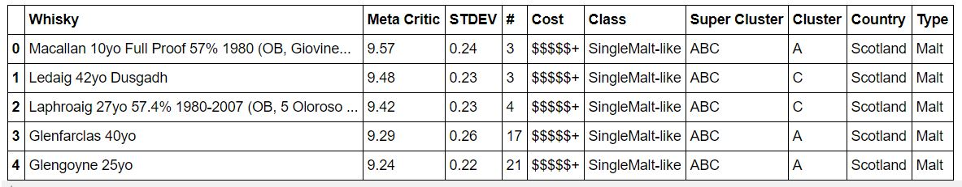
The Data:
https://whiskyanalysis.com/index.php/database/
Containing almost 1800 whiskies.

Slide 6
The Process
Several models were created using a variety of methods:
Decision Trees
Random Forests
Ada Boost
Gradient Boost
Xtreme Gradient Boost

Slide 7
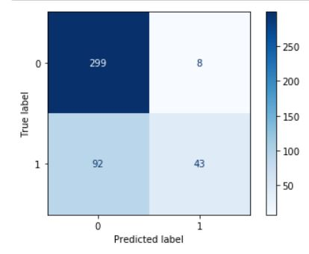
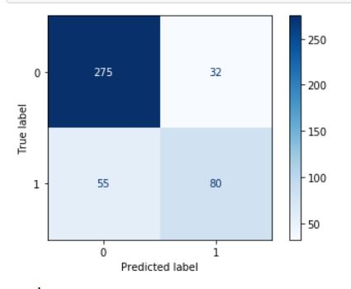
Results
Ada Boost model
Decision Tree model

Slide 8
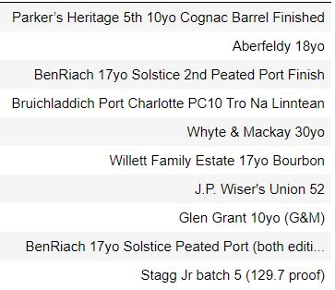
Results, con’t
Recommendations:
Future considerations/improvements:
Improved/more data
More work on ‘cluster’

Slide 9
Thank you.
Questions?
djournic@gmail.com

